Slide 1

WASTE AND DONATION MANAGEMENT
MENTOR : DR.R.RAJA SUBRAMANIAN
STUDENT : DINESH KARTHIK M
REG : 99220040836

Slide 2
ABSTRACT
Creating a Waste and Donation Management Website is a commendable initiative
Create forms where users can report different types of waste materials.
Implement dropdown menus or checkboxes for easy categorization (e.g., plastic, paper, electronic waste).
Environmental Tips: Share tips on reducing waste, composting, and conserving resources.

Slide 3
OBJECTIVE
Efficient Waste Management: Streamline the process of waste reporting, categorization, and disposal, making it easier for individuals and organizations to manage waste responsibly.
Promote Recycling and Conservation: Educate users about the importance of recycling and conservation through informative resources and guides, encouraging the adoption of sustainable practices.
Facilitate Donation Transactions: Provide a user-friendly platform for users to donate various resources such as food, clothing, and supplies, connecting donors with individuals or organizations in need.

Slide 4
TECH STACK
●HTML
●CSS
●JAVASCRIPT

Slide 5
WORKFLOW Waste and Donation Management
PLAN
CONTENT CREATION
HTML STRUCTURE
INTERACTIVE ELEMENTS(JS) ,CSS STYLING
TESTING AND DEPLOYMENT

Slide 6
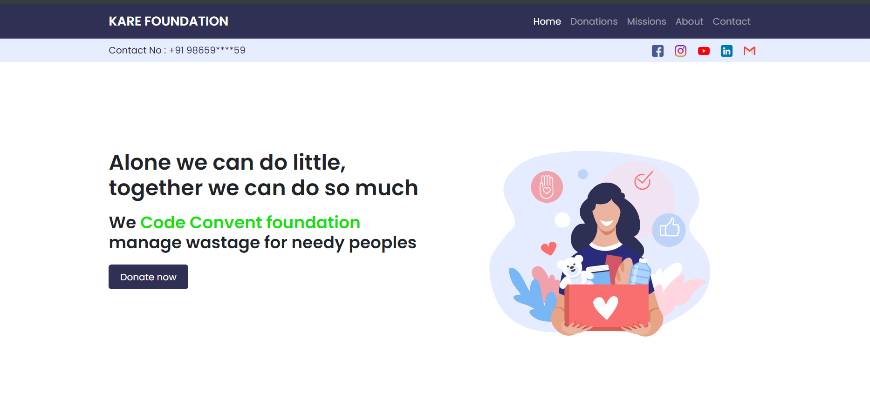
OUTPUT

Slide 7
CONCLUSION
The development of the Waste and Donation Management Website represents a significant step towards addressing pressing environmental and social challenges.
Through the integration of innovative technologies and thoughtful design, this project aims to streamline waste management processes, facilitate resource redistribution, and foster community engagement

